Slide 1
🚀 From Java Learner to Interview-Ready and Expert Engineer
Learn → Explain → Crack Interviews Become a Confident Java Developer
Stop memorizing. Start using Java.
Online | Limited seats | Real-world focus
Notes:
Introduce yourself briefly. Set expectation: this session is about clarity and confidence, not shortcuts.

Slide 2
Who Should Attend This Demo?
Struggling with Java core concepts & real-world usage
Confused interview preparation leading to failures
Lack of confidence explaining project design
Notes:
Ask audience to react in chat or raise hand if they relate to any point.

Slide 3
Why Most Java Developers Fail Interviews
No focus on important Java concepts
Lack of coding practice and real project understanding
Fear and low confidence during interviews
Notes:
Share 1–2 real interview experiences you have seen.

Slide 4
What I am going to cover?
Must-know concepts
Top interview & real-world questions
Essential coding practice
Notes:
Position yourself as mentor, not lecturer.

Slide 5
What You’ll Learn??
All must-know Java concepts
Real-world project-based explanations
ATS-friendly resume & job guidance
🎯 Outcome:
Crack Java interviews with confidence
Work smoothly on real projects
Notes:
Position yourself as mentor, not lecturer.

Slide 6
MY Teaching Approach
Clear explanation of each concept
Real coding examples with a demo project
Explanation of where and why the concept is used
Top interview, real-world, and practice questions
Complete materials with source code provided
Notes:
Position yourself as mentor, not lecturer.

Slide 7
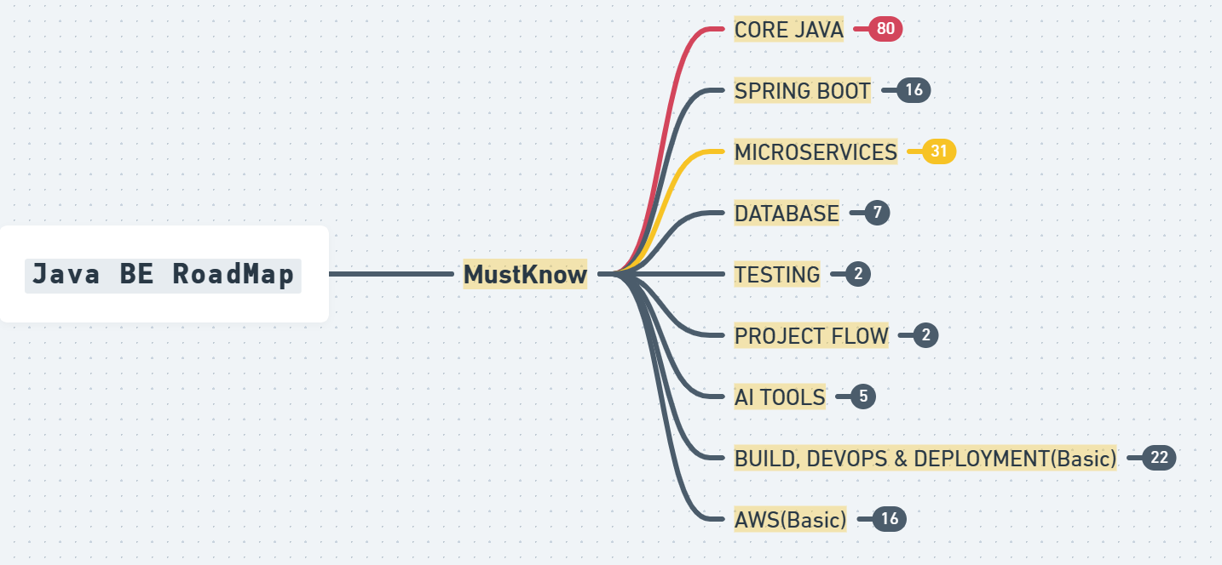
Please access roadmap: https://whimsical.com/java-backend-developer-roadmap-TjjeMawpcyfsnPnngcD7r8
Notes:
Create curiosity. Ask them to attend next demo.

Slide 8
Final Thought
Prepare alone OR prepare with clarity and confidence
Your growth. Your choice.
Thank you for attending
Notes:
End calmly. Invite questions.

